Slide 1
Introduction of
Annual Review

Slide 2



Purpose of Annual Interview
INDIVIDUAL
COLLECTIVE
OVERVIEW
Enable each of us to express and establish the necessary conditions for work accomplishment and professional development
Support Anywr in a phase of profound transformation, by optimizing our internal resources and their organization.
Better understand the human potential of Anywr and to implement relevant strategies
A WIN-WIN GAME; ECONOMIC AND HUMAN!
Notes:
FREE IMAGES RESOURCES: FLATICON AND STOCKIO

Slide 3
Key players and roles
Manager
Assess their team by the detailed criteria in frame of the annual interview and consequently identify the talents for Anywr.
Is the center of the process: they are both empowered and accountable because they hold the primary responsibility for identifying and developing their teams
Dedicate time and energy to the development of those in own team.
Collaborator
Take ownership for own development
Ensure adherence to the process and guidelines, promoting a more transversal approach
Facilitate collective discussion and validation of the final talent pool by 9 box during Talent Review ( After the campaign of Annual Interview campaign)
Provide guidance to the manager and the member to define Personal Development Plan (PDP) and insure the career path follow-up
HR

Slide 4


Who is involved?
1
2
3
4
Before the annual interview campaign
Preparation of the annual interview meeting
During the annual interview meeting
After the annual interview meeting
✓
✓
✓
✓
Manager
Collaborator
✓
✓
✓
✓
✓
✓
✓
HR

Slide 5
1
Before the annual interview campaign
HR
Communication for HR Calendar
Individual OKR
Collaborator
Propose individiual OKR and discuss with his/her manager
Manager
Collect team’s individual OKR, to be validated by manager’s direct report (N+2)
Send the team individual OKR to HR for documentation
Kick-off meeting for annual interview campaign

Slide 6
2
Preparation of the annual interview meeting
A week before the schedule annual meeting
 | First step | Second step | Third step
Who | Manager | Collaborator | Manager
Action | Send the meeting invitation on Teams at least 1 week before the schedule annual interview meeting | Make the self-evaluation by completing the form Then send the filled form to manager at least 3 days in advance the interview | Once receive the form from collaborator, complete the evaluation before the meeting
By | Setting the Agenda | Preparing for the Interview: Take time to reflect on your performance over the past year. Identify key achievements, challenges faced, and areas for improvement. Reviewing Goals: Assess the progress made toward the goals set in the previous year. Be prepared to discuss the outcomes, challenges faced, and any adjustments needed | Reviewing Performance Data: Managers should familiarize themselves with the employee's performance data, including achievements, areas for improvement, and any relevant metrics. Gathering Feedback: Collect feedback from colleagues, team members, and other stakeholders to gain a comprehensive understanding of the employee's contributions and impact.

Slide 7
3
During the annual interview meeting
As a manager,
the role is to lead the interview
As a collaborator,
it is important to engage in the dialogue
HR will accompany Anywrers during the campaign
HR ticketing system has new function to send request when you need support. A way to have data analysis for next HR improvement
Open communication
2024 OKR review
Acknowledge Achievements
Provide Constructive Feedback
Address Concerns
Discuss Career Development and give advice
Actively participate in the discussion
Highlight Contributions
Accept Constructive Feedback
Clarify Misunderstandings
Express Development Needs
Commit to Learning
Drive to reach the agreement and put signature on the form
Approach the discussion with a positive and professional attitude, even addressing challenging concerns
Review the past, Talk about present, Plan for future

Slide 8
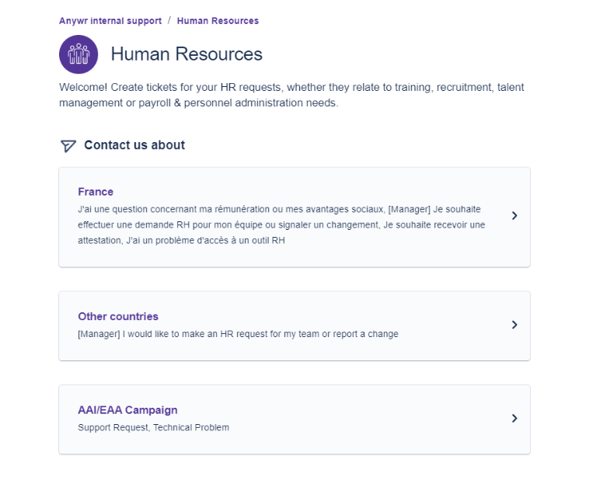
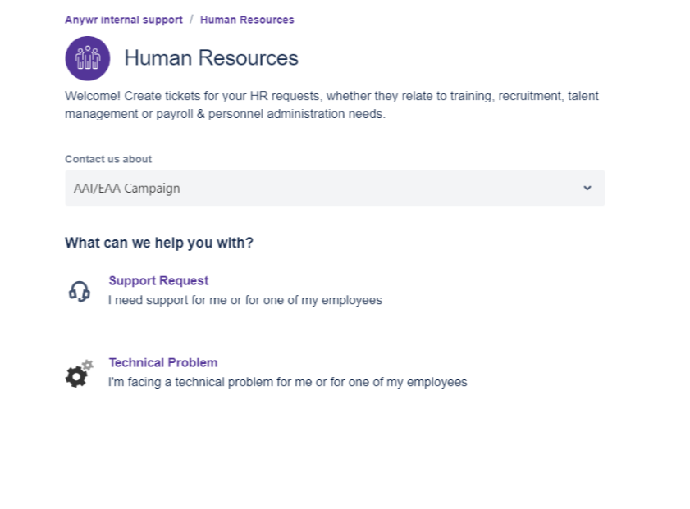
HR ticket support

Slide 9
4
Attention
After the annual interview meeting
Once it is completed, please send to HR.
Email: campagnesrh@anywr-group.com
As a manager
As a collaborator
HR
Documentation
Keep the forms with signatures.
Commit to individual OKR
Send digital copies to HR, email:
Request supports
Demonstrate Accountability
continuous support
Be available
Regular check-in meeting.
Manage the data extraits to prepare variable, and Talent Review/Salary Review
Will announce more info in mid Feb for the next HR actions

Slide 10
Guide for Annual Interview Form

Slide 11
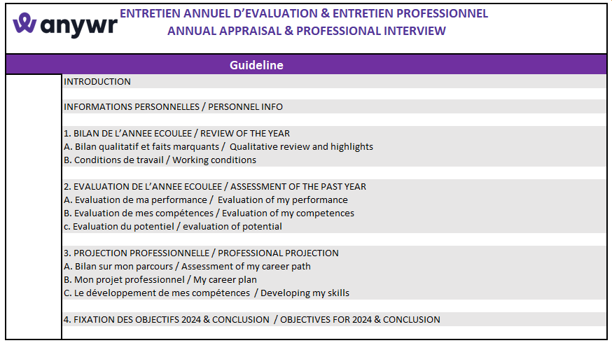
1st worksheet: Guideline
6 worksheets on Excel, in French and English

Slide 12
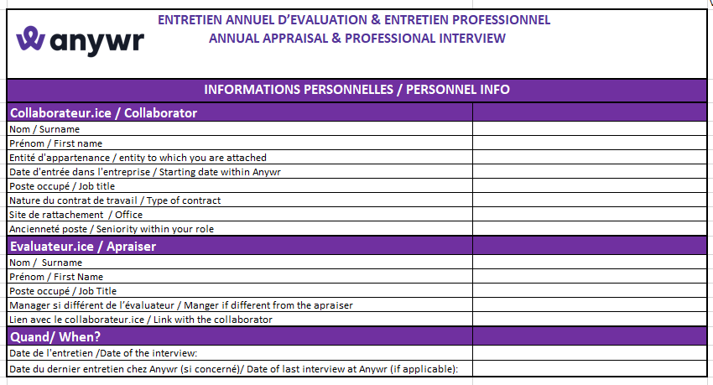
2nd worksheet : personnel Info

Slide 13
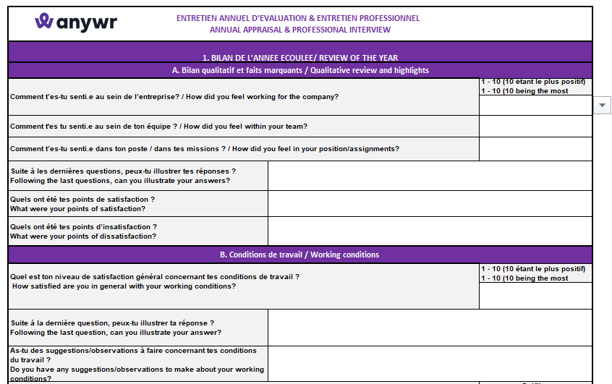

3rd worksheet : Review of the year
Click on the column below the question, will appear as scroll-down list.

Slide 14
4th worksheet : Performance assessment
Performance
Performance is a mix between the results (How much) and the way we built the results (How) .
OKRs’ achievement of the past year
Transversal competences assessment
Potential
The potential reflects the behaviour and attitude that a person has to build a high performance and his/her ability to enlarge or take a more complex scope of responsibilities.
Assessed by drivers and traits
The global performance will be assessed through 9 box matrix crossing global performance % and the global potential %

Slide 15
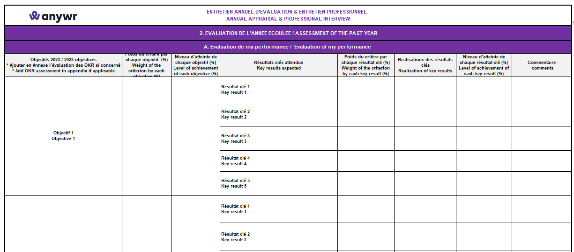
4th worksheet : Performance assessment
Part A. evaluation of the performance ( OKR 2023)

Slide 16
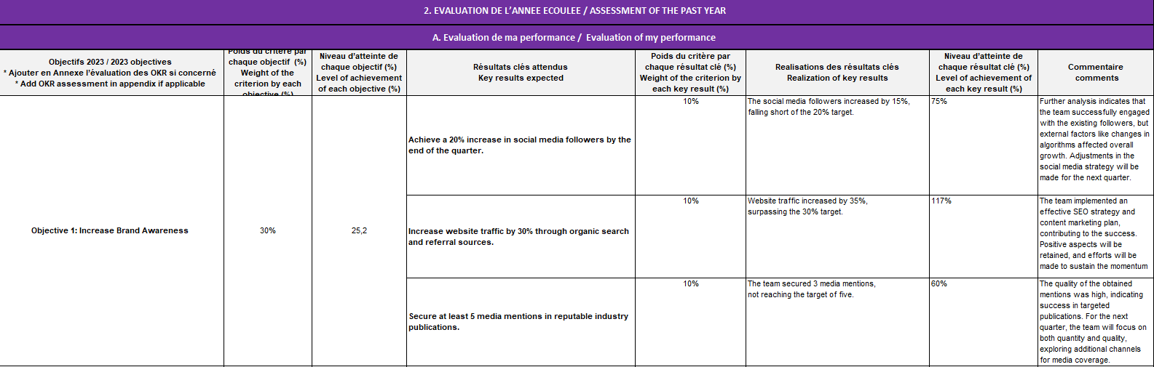
Example
= (10%*0.75) +
(10% %*11.7) +
(10% *0.6)
Overpass the target, 120% as max.
Concern to variable will be validated by Comex.

Slide 17
4th worksheet : Performance assessment
Part B. evaluation of competences
Great customer / talent service:
Demonstrate active listening (without preconceived ideas) demonstrating empathy and openness to ensure a detailed understanding of their needs and place the customer / talent at the heart of their decisions
Inspired by internal or external best practices and support a "data driven" approaches to enrich the internal or external customer / talent experience
Respect his/her commitments to customer / talent in terms of deliverables, quality and timeline
Communicate with its clients /talents to get their feedbacks and ensure a high standard in terms of quality of services
Results & data driven:
Set up clear and achievable objectives and define ambitious targets
Set up SMART OKRs to follow its activities
Collect, assess, analyse data to track his/her progress, to make the right decision to achieve his/her goals and take any preventive actions needed
Deliver the results targeted or above
Organization:
Set milestones with timelines/deadlines to achieve its global objectives in accordance with the budget
Establish priorities and monitor his/her daily performance demonstrating stability and resilience in the face of adversity and remains focused on what is important to deliver on commitments
Identify critical tasks to anticipate and put steps in place to mitigate potential issues/problems
Show ability to use planning / organisation tools
Work together:
Maintain a spirit of collaboration that goes beyond silos (employees and partners) and create a transversal network, even beyond its organization, to achieve together the set objectives
Listen to other team members, taking everyone’s ideas on board and not just his/her own
Communicate in a proper way with all members respecting each individual for its differences and with benevolence
Dare to have a say and share responsibilities

Slide 18
CORE COMPETENCIES
4th worksheet : Performance assessment
Part B. evaluation of competences
Inspiring leadership:
Build efficient teams through their complementarity and diversity to enrich corporate practices and culture
Develop its employees by co-constructing individualized paths and support them in their new challenges
Adapt its decision speed; act despite uncertainty, incomplete information and / or context-related risks; take responsibility/ownership
Share and embody the vision, to engage teams, ensure their understanding
Transmit energy to others and generate the will to fit into the culture of Anywr Group
Bring together and engage all stakeholders around a common direction that promotes alignment, movement and collective success
Nurture the passion:
Engage to change lives everyday for all
Put the quality of our services as its top priority
Strive every day for excellence in every tasks done, in every details that make the difference
Act as an ambassador of our brands and of the company
Give feedback:
Empower its employees within a defined scope and specify its level of requirement. Evaluate results using shared OKRs
Promote and give visibility to collective contributions
Demonstrate managerial courage to provide feedback, including difficult ones, with clarity and authenticity

Slide 19
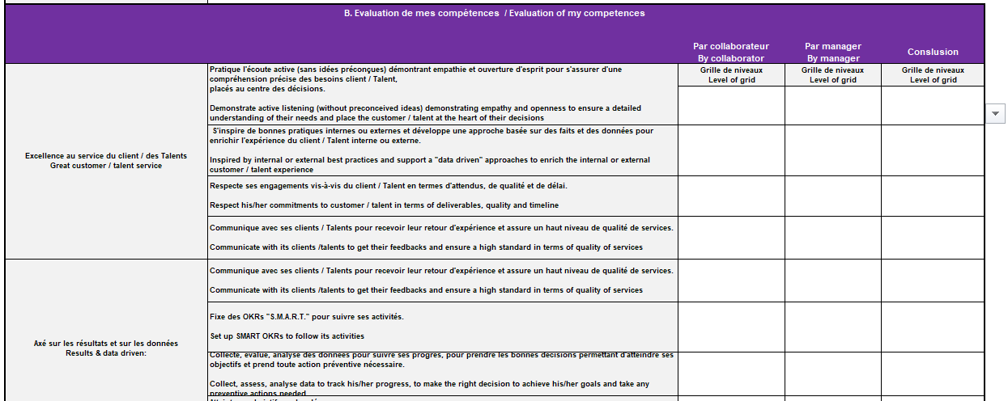

4th worksheet : Performance assessment
Part B. evaluation of competences
Click on the column below the question, will appear as scroll-down list.

Slide 20
4th worksheet : Potential assessment
Part C. evaluation of potential
Facilitating traits
“Facilitating traits” are personal attributes – what comes naturally and what requires effort – that exert a strong influence on behavior.
These increase the likelihood of success.
Decision maker: uses critical thinking skill to find solutions to problems by assessing the alternatives resolutions and then decides the more appropriate action
Accountable: has the courage to do what he/she says and to say what he/she does within internal guidelines and take the ownership of its actions & performance
Go-getter: has a strong drive to achieve its goals and understand clearly what he/she must do to stay on track toward achieving these objectives
Flexible: adapts quickly to changes or new circumstances by changing its plans to overcome unanticipated obstacles while remaining focused on goals
Deal with pressure remains calm and stays focused on what needs to be accomplished in any circumstances, keeps positive facing challenges, does not give up in the face of adversities
Counterproductive traits
“Counterproductive traits” are also personal attributes, but which can become significant obstacles to growth and development
Narrow view: focuses on the short term especially when faced with urgent situations without taking more broadly to his/her long-term ecosystem
Individualism: manages and centralizes information to make decisions to his/her advantages or his/her ecosystem advantage above group interest
Resistance to change has a fixed mindset, anchored to his/her ideas and rejects any opportunities to change

Slide 21
4th worksheet : Potential assessment
Part C. evaluation of potential
Drivers describe the the sources of motivation, that creates engagement and energy for the work an individual does; the individual will be energized by his/her work to the extent it is aligned with his /her drivers (be used during recruitment process to assess the fit with the company).
Interest and motivations
Social impact: contributing to a societal project with a strong impact changing lives every day for all.
Community: being part of communities and having several opportunities to learn from teamwork and collective sharing
Freedom of actions: in a defined playground, having a scope for action and necessary resources in order to identify opportunities and building solutions while maintaining Anywr Group’s DNA
Innovation: proposing, experimenting with, and developing new and creatives ideas
Transformation: being actively engaged in the growth effort of Anywr Group

Slide 22
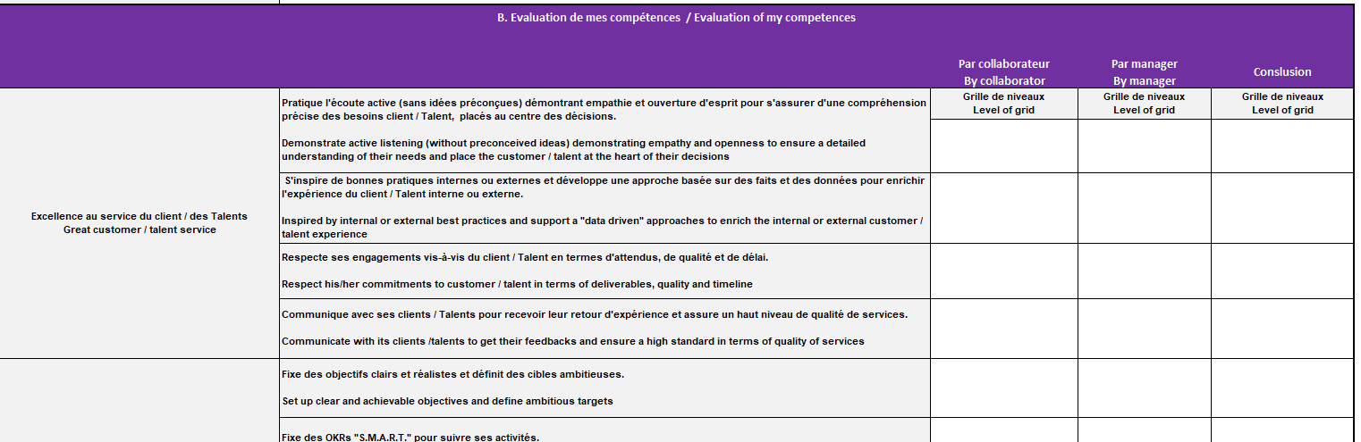
4th worksheet : Potential assessment
Part C. evaluation of potential
Click on the column below the question, will appear as scroll-down list.

Slide 23
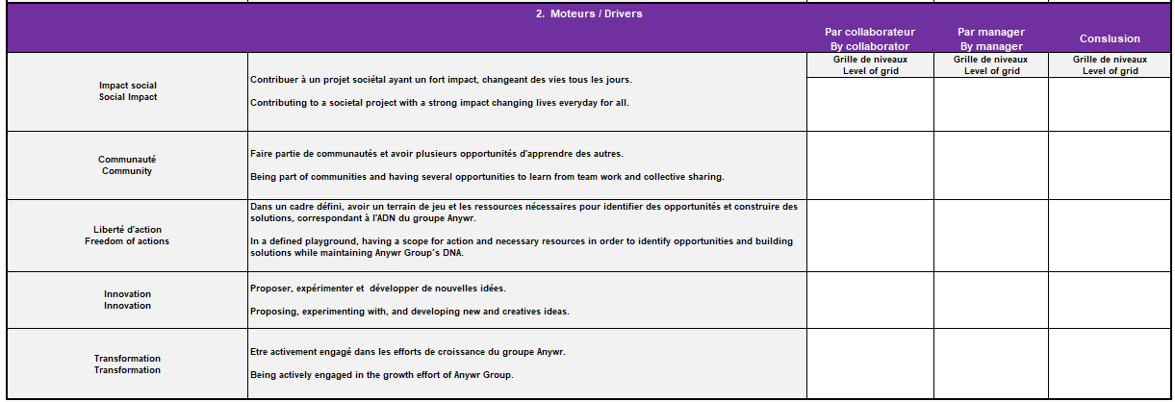
4th worksheet : Potential assessment
Part C. evaluation of potentiality
Click on the column below the question, will appear as scroll-down list.
Attention
Collaborators will make the self-evaluation first, then afterwards manager will do the evaluation , last column is the conclusion, which shall be discussed and agreed during the meeting

Slide 24
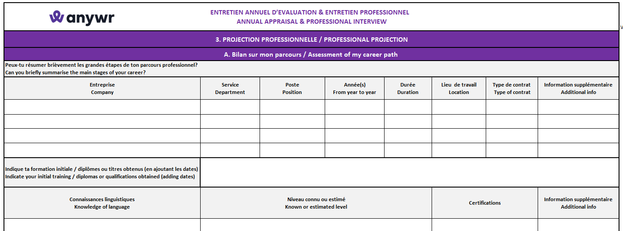
5th worksheet : Professional Projection
Part A. Career History
Part B. Career Plan
Part C. Skill Developing Plan

Slide 25
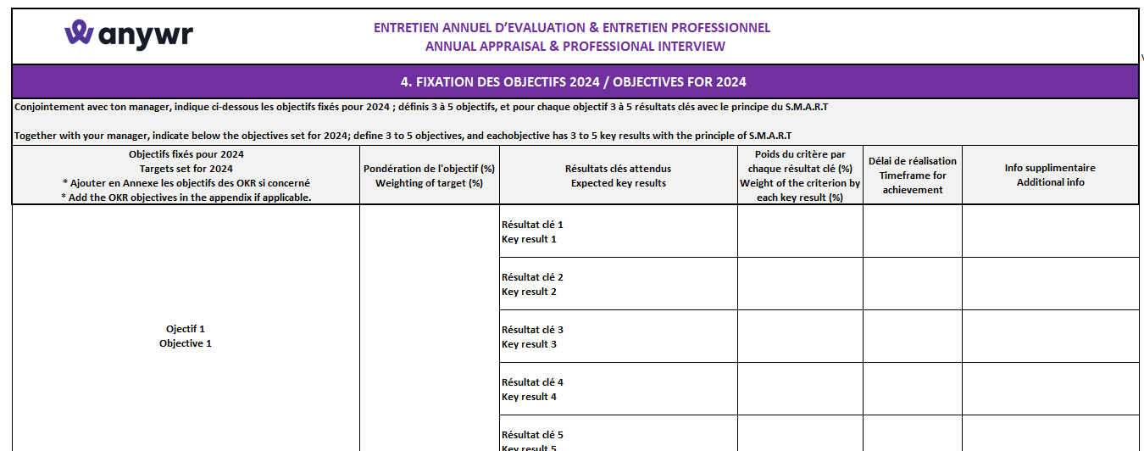
6th worksheet : Obj 2024 & Conclusion
Part A. OKR 2024
Part B. Conclusion
Attention
Manager and collaborator have to sign below the conclusion!!

Slide 26
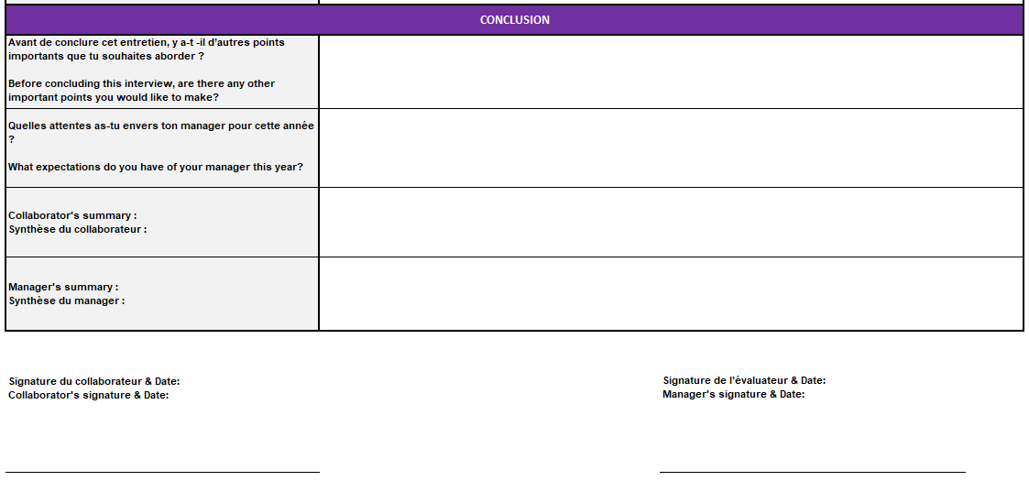
6th worksheet : Obj 2024 & Conclusion
Part B. Conclusion
Attention
Manager and collaborator put a digital signature on the conclusion!!
How to insert a digital signature on Excel:
Instruction video
Instruction by MS

